Slide 1

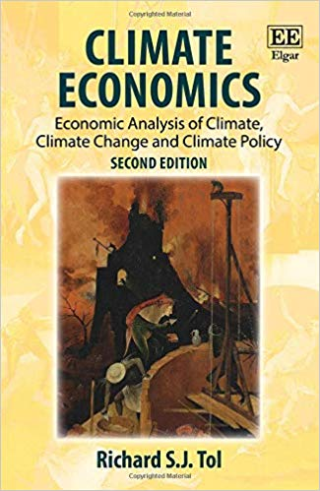




The Structure of the Climate Debate
Richard S.J. Tol
University of Sussex
Vrije Universiteit, Amsterdam
Tinbergen Institute
CESifo
Payne Institute

Slide 2
Outline
Estimates of the impact of climate change
Why exaggerate?
Climate policy design and intensity
The state of the climate debate

Slide 3
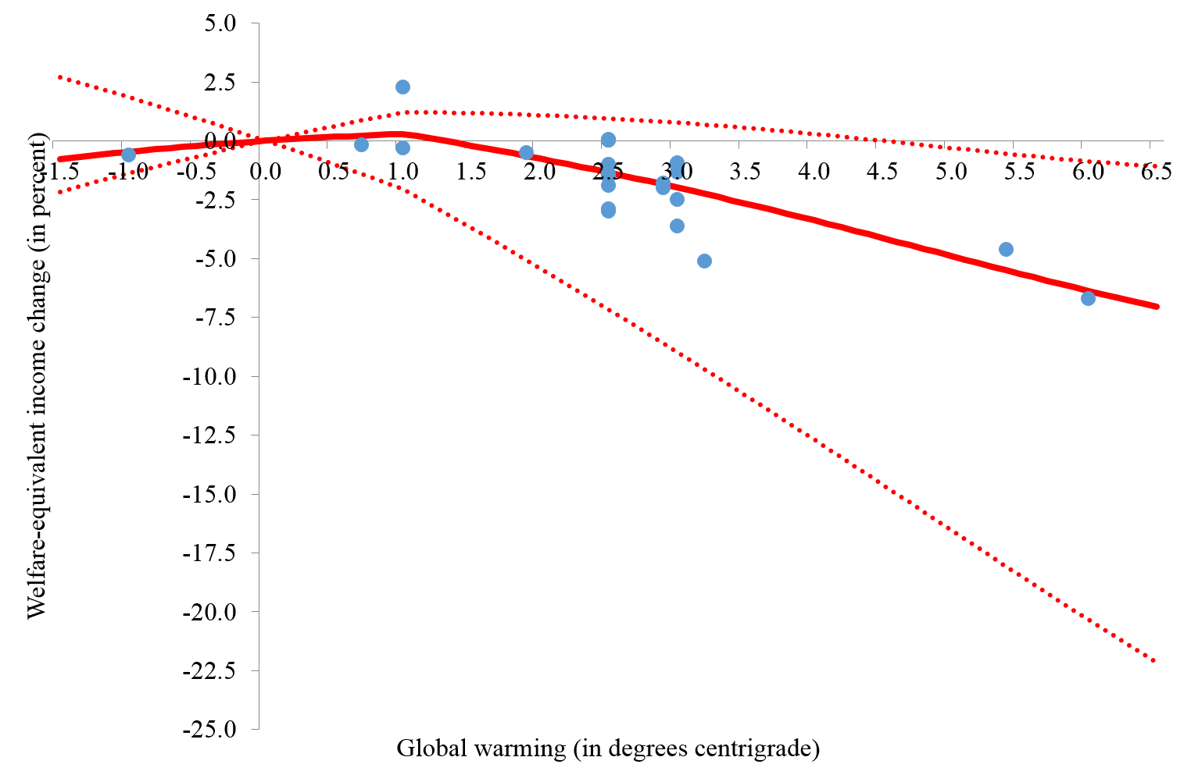
Initial effects net
positive, but sunk
More pronounced
warming net negative
Rough agreement on
effect size, despite
different methods used
Large, asymmetric
uncertainty
Tol REEP 2019

Slide 4
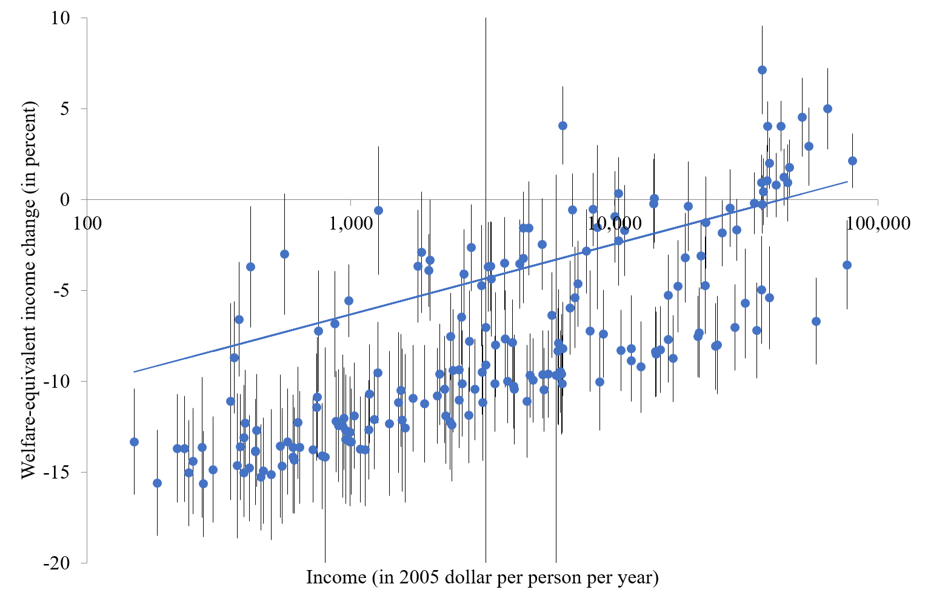
Exposure
Tol REEP 2019

Slide 5
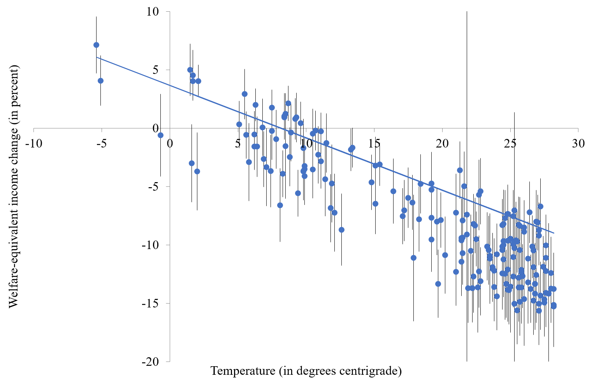
Exposure
Limits / analogues
Tol REEP 2019

Slide 6
Exposure
Limits / analogues
Adaptive capacity
Tol REEP 2019

Slide 7
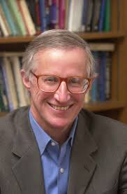
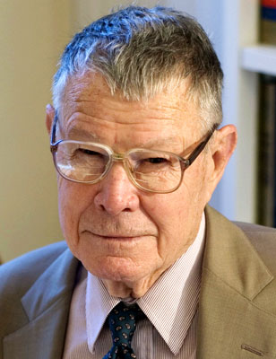
Stock take
The impact of climate change on human welfare seems modest (Nordhaus EJ 1991)
The largest impacts are rather symptoms of underdevelopment and mismanagement (Schelling AER 1992)
So why do people believe that climate change is an existential threat?

Slide 8
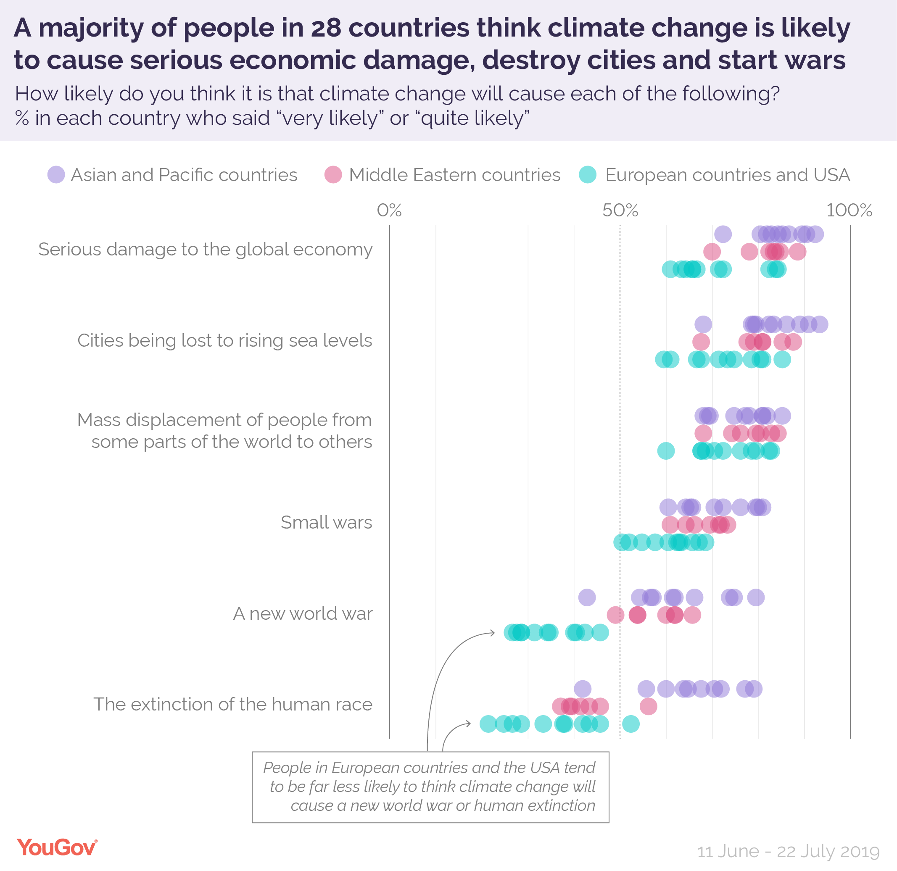

Slide 9


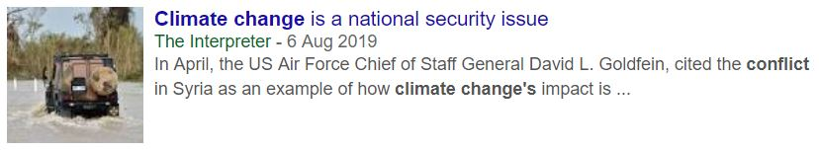

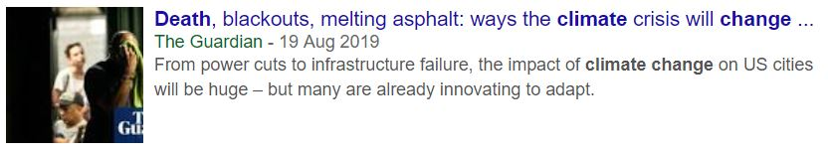
The end is nigh
Milleniarianism has a long tradition

Slide 10
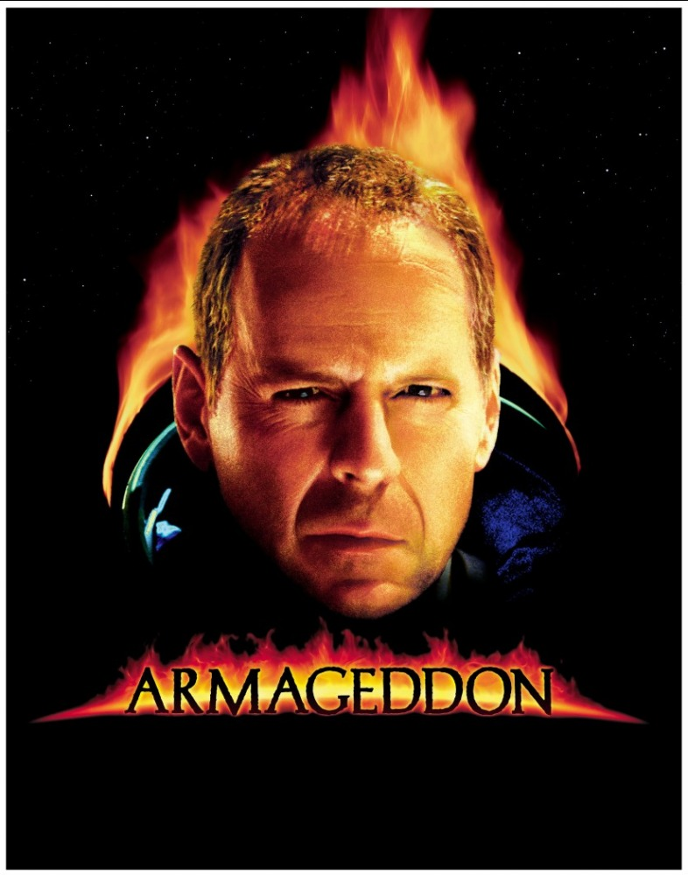
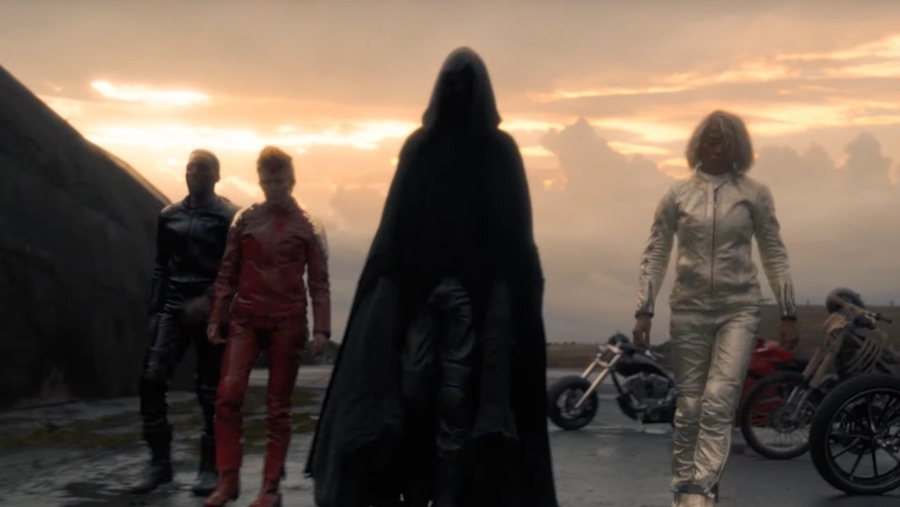
Motivation
The old stories are the best
Cast your message in an old narrative
Journalists like to sell newspapers
Environmentalists like to get donations
Politicians like to be Bruce Willis
You can’t save the world if its not threatened

Slide 11
Climate policy design
The cheapest way to meet any target is to equate the costs of emission reduction at the margin
This can be done by a carbon tax or cap and trade
A carbon tax brings price certainty, cap and trade brings emissions certainty
Price certainty is worth more
A carbon tax, a uniform carbon tax, and nothing but a carbon tax
Carbon tax should increase over time with something akin to the interest rate

Slide 12
Tol REEP 2019

Slide 13
Current price of emissions permits in EU: ~190 $/tC
California / Quebec: ~65 $/tC
Beijing: ~45 $/tC

Slide 14
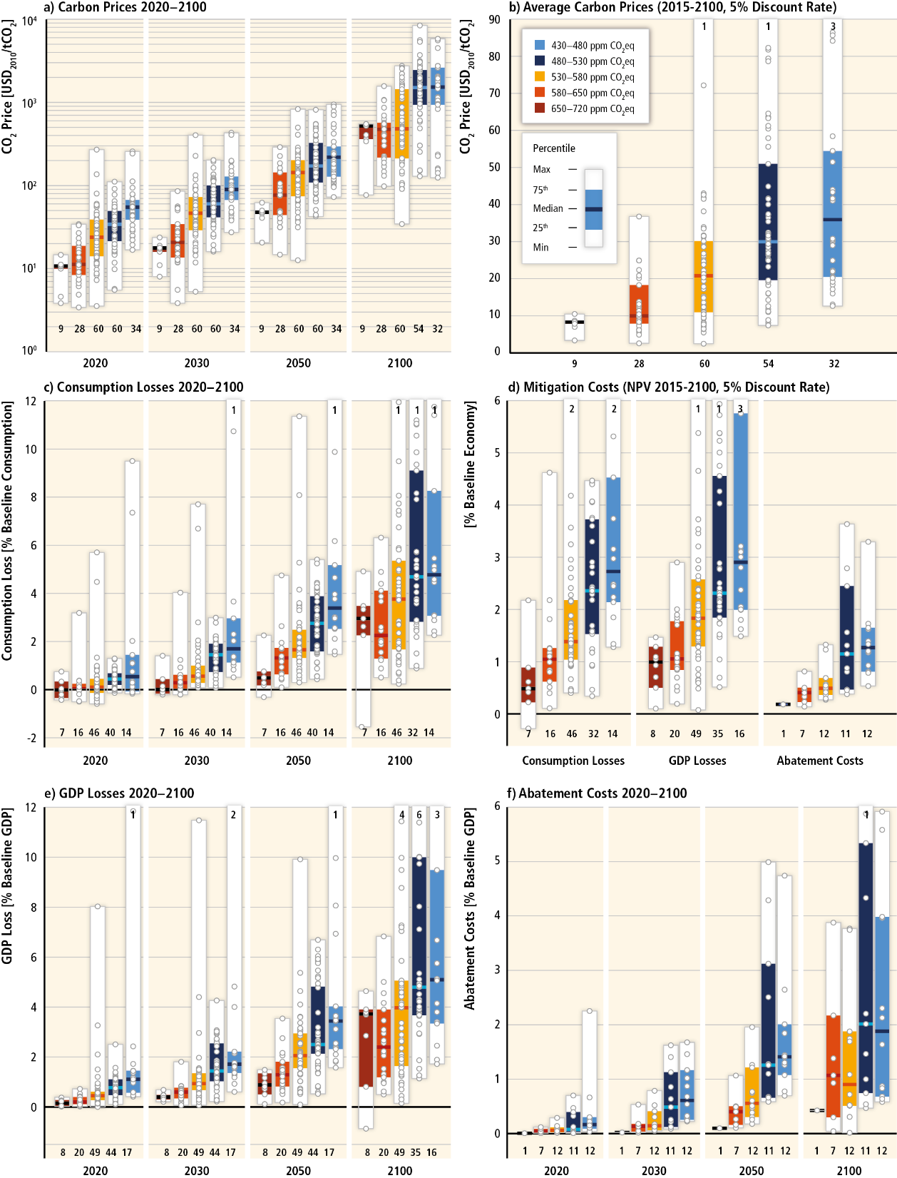

Slide 15
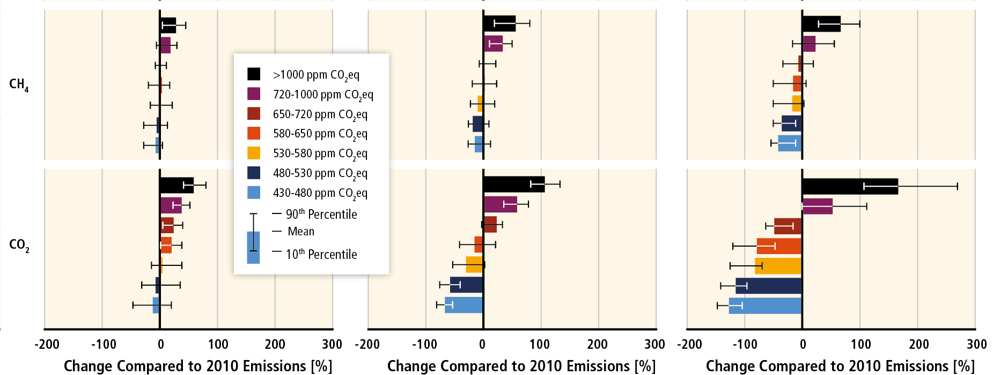

Slide 16
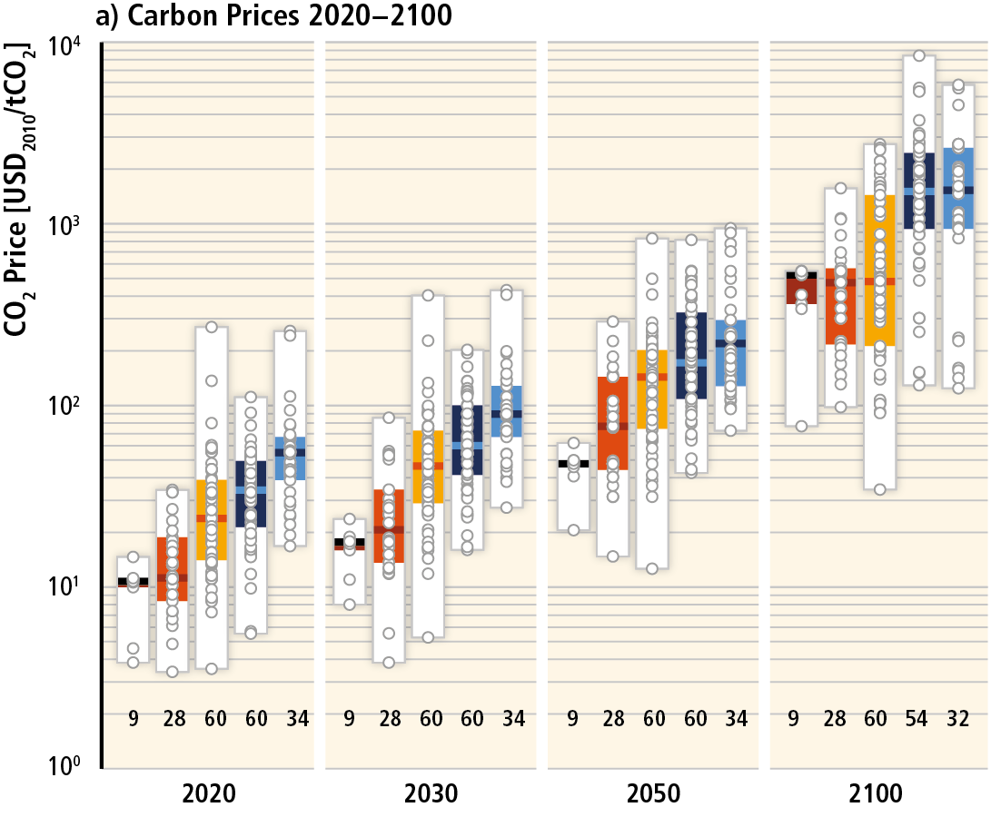

Slide 18
Stock take
So, climate change is a smallish problem with a simple solution: A carbon tax, a uniform carbon tax, and nothing but a carbon tax
What is all the fuss about?
Partly, greenhouse gas emission reduction is a global public good
Partly, climate policy is a wicked problem
Partly, the politics is in a bad equilibrium, with unrealistic expectations and a focus on anything but emission reduction

Slide 19
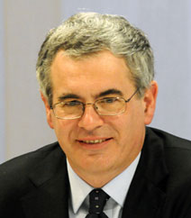

International climate policy
The foundations of international climate policy were laid between 1985 (Villach) and 1992 (Rio).
From 1995 (Berlin) to 2009 (Copenhagen), the aim was to agree on legally binding emission targets.
This failed as predicted: Greenhouse gas emission reduction is a global public good.
All benefit from one’s emission reduction (non-excludability) and one’s benefits do reduce others’ benefits (non-rivalry).
Public goods are underprovided, unless there is a regulator to enforce contributions.
Intended nationally determined contributions were introduced in 2014 (Lima) and confirmed in 2015 (Paris).

Slide 20
Stock take
So, climate change is a smallish problem with a simple solution
What is all the fuss about?
Partly, greenhouse gas emission reduction is a global public good
Partly, climate policy is a wicked problem
Partly, the politics is in a bad equilibrium, with unrealistic expectations and a focus on anything but emission reduction

Slide 21
A wicked problem
A problem is wicked if
No stopping rule
Solutions are better or worse, not right and wrong
Actions have irreversible consequences
Terrible jargon: Illiteracy among 6 year olds is a wicked problem
Build a broad consensus on the direction of travel, build institutions to keep at it

Slide 22
Paris Agreement
4.2 Each Party shall prepare, communicate and maintain successive nationally determined contributions that it intends to achieve. Parties shall pursue domestic mitigation measure with the aim of achieving the objectives of such contributions.
4.3 Each Party’s successive nationally determined contribution will represent a progression beyond the Party’s then current nationally determined contribution […].
4.11 A Party may at any time adjust its existing nationally determined contribution with a view to enhancing its level of ambition […].

Slide 23
Stock take
So, climate change is a smallish problem with a simple solution
What is all the fuss about?
Partly, greenhouse gas emission reduction is a global public good
Partly, climate policy is a wicked problem
Partly, the politics is in a bad equilibrium, with unrealistic expectations and a focus on anything but emission reduction

Slide 24
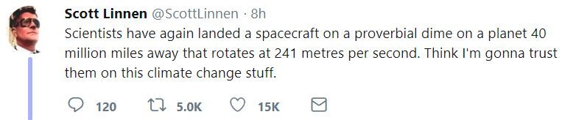
The role of science
Church offered a theory of how the world works, and how to behave
The Enlightenment separated “what if” from “what to do”
Science is now so vast and complex that we accept arguments based on authority in a discipline

Slide 25
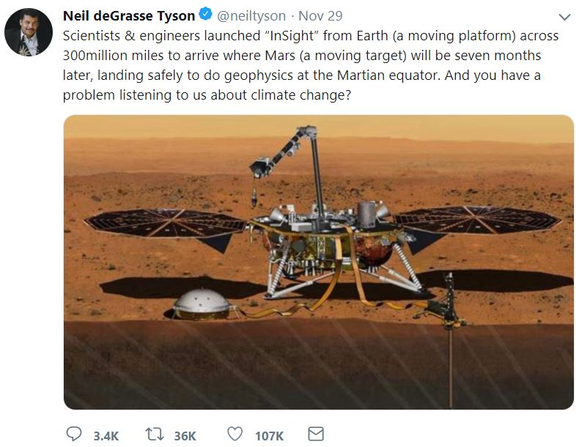

Slide 26
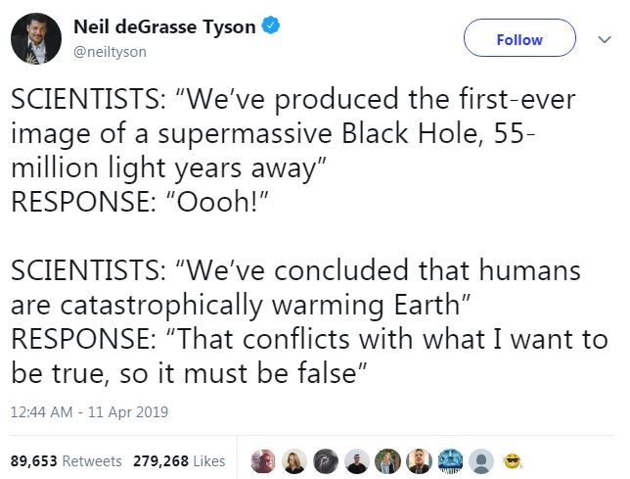


Slide 27
Players and incentives
Church offered a theory of how the world works, and how to behave
The Enlightenment separated “what if” from “what to do”
Science is now so vast and complex that we accept arguments based on authority in a discipline
Facts and morals derive from different authorities
Some find that confusing, and attach moral authority to science
Some academics enjoy that status
Some argue that because we’re smarter, we’re also better, wiser

Slide 28
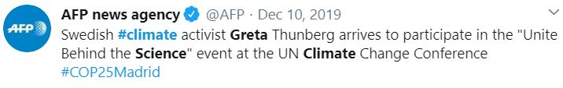
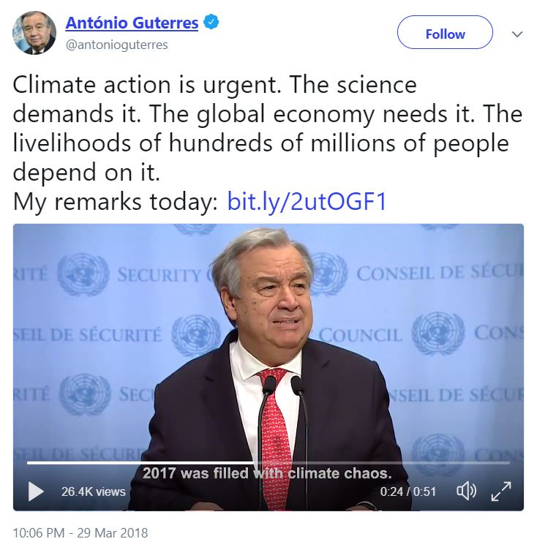

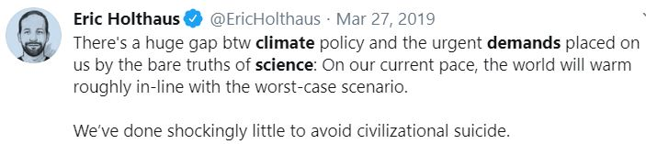
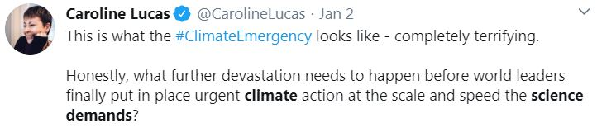
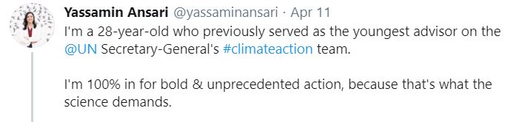
Fallacies
Climate policy is often phrased as a scientific imperative

Slide 29
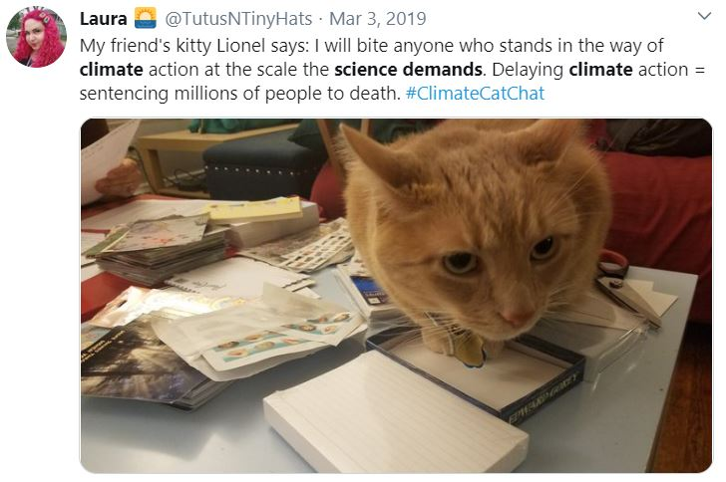

Slide 30
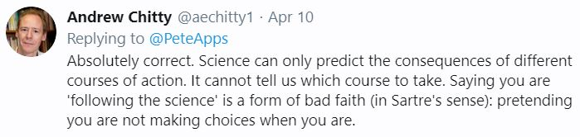
Fallacies
Climate policy is often phrased as a scientific imperative
This absolves politicians from the choices they make

Slide 31
Players and incentives
A carbon tax is an excise on energy and food. We already have such excises, so a small team in the Treasury is enough for climate policy
Instead, we have observed a rapid expansion of the number of civil servants working on a rapidly expanding climate bureaucracy

Slide 33
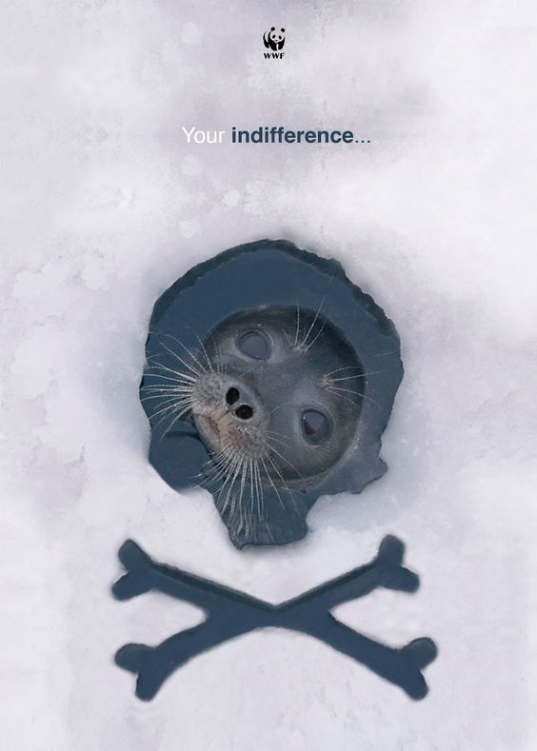
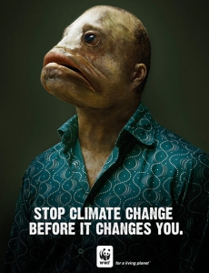
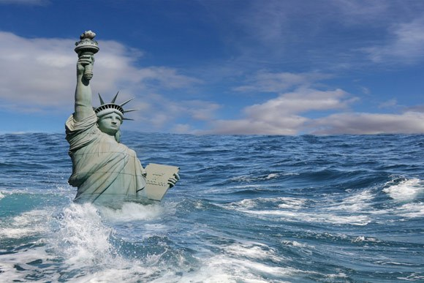
Players and incentives
Climate change is a discourse of fear: Emissions are sin, climate change a final reckoning
Environmentalists, like priests, offer redemption, moral superiority, a tribe to belong to
Tithes offer income and influence

Slide 34
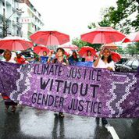
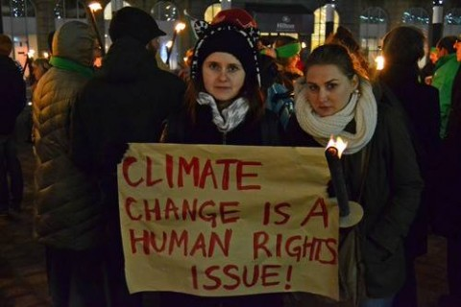
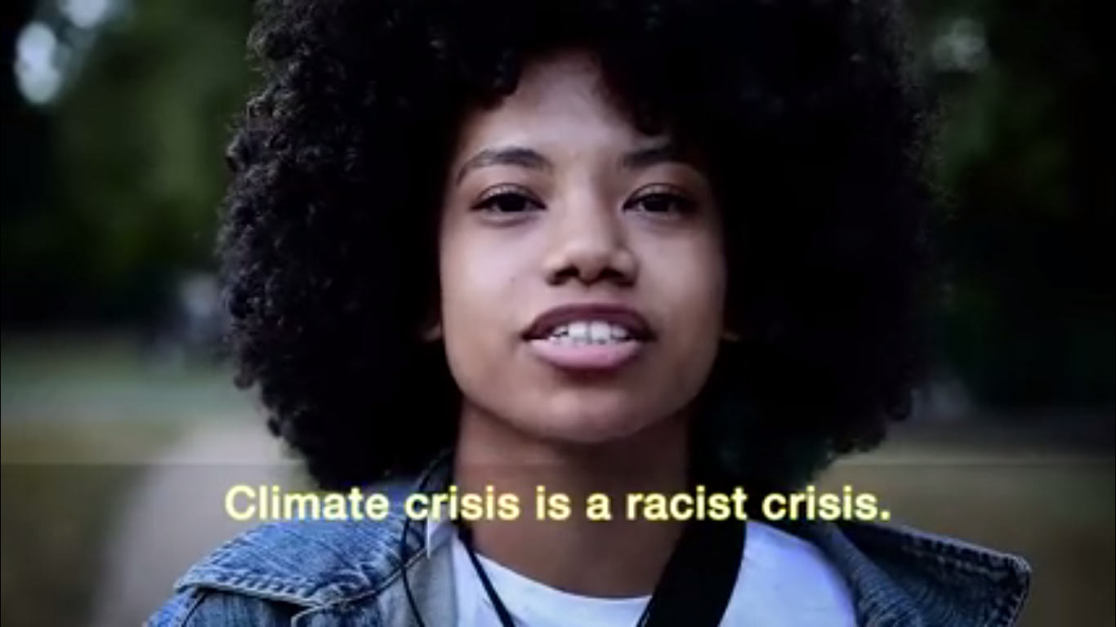
Players and incentives
Climate change is a band-wagon for other good causes

Slide 35
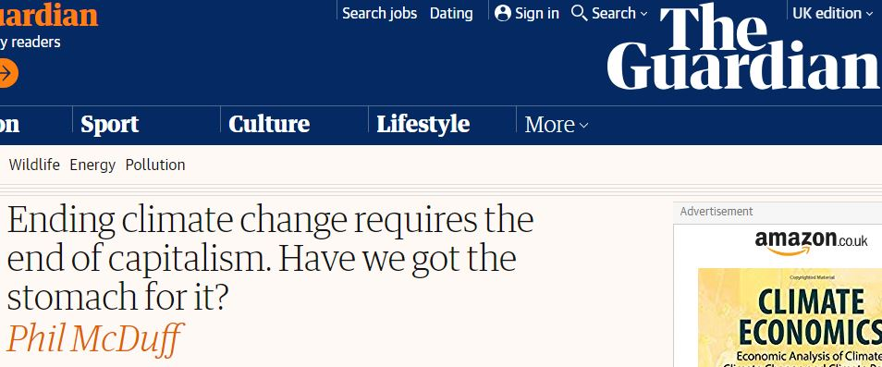
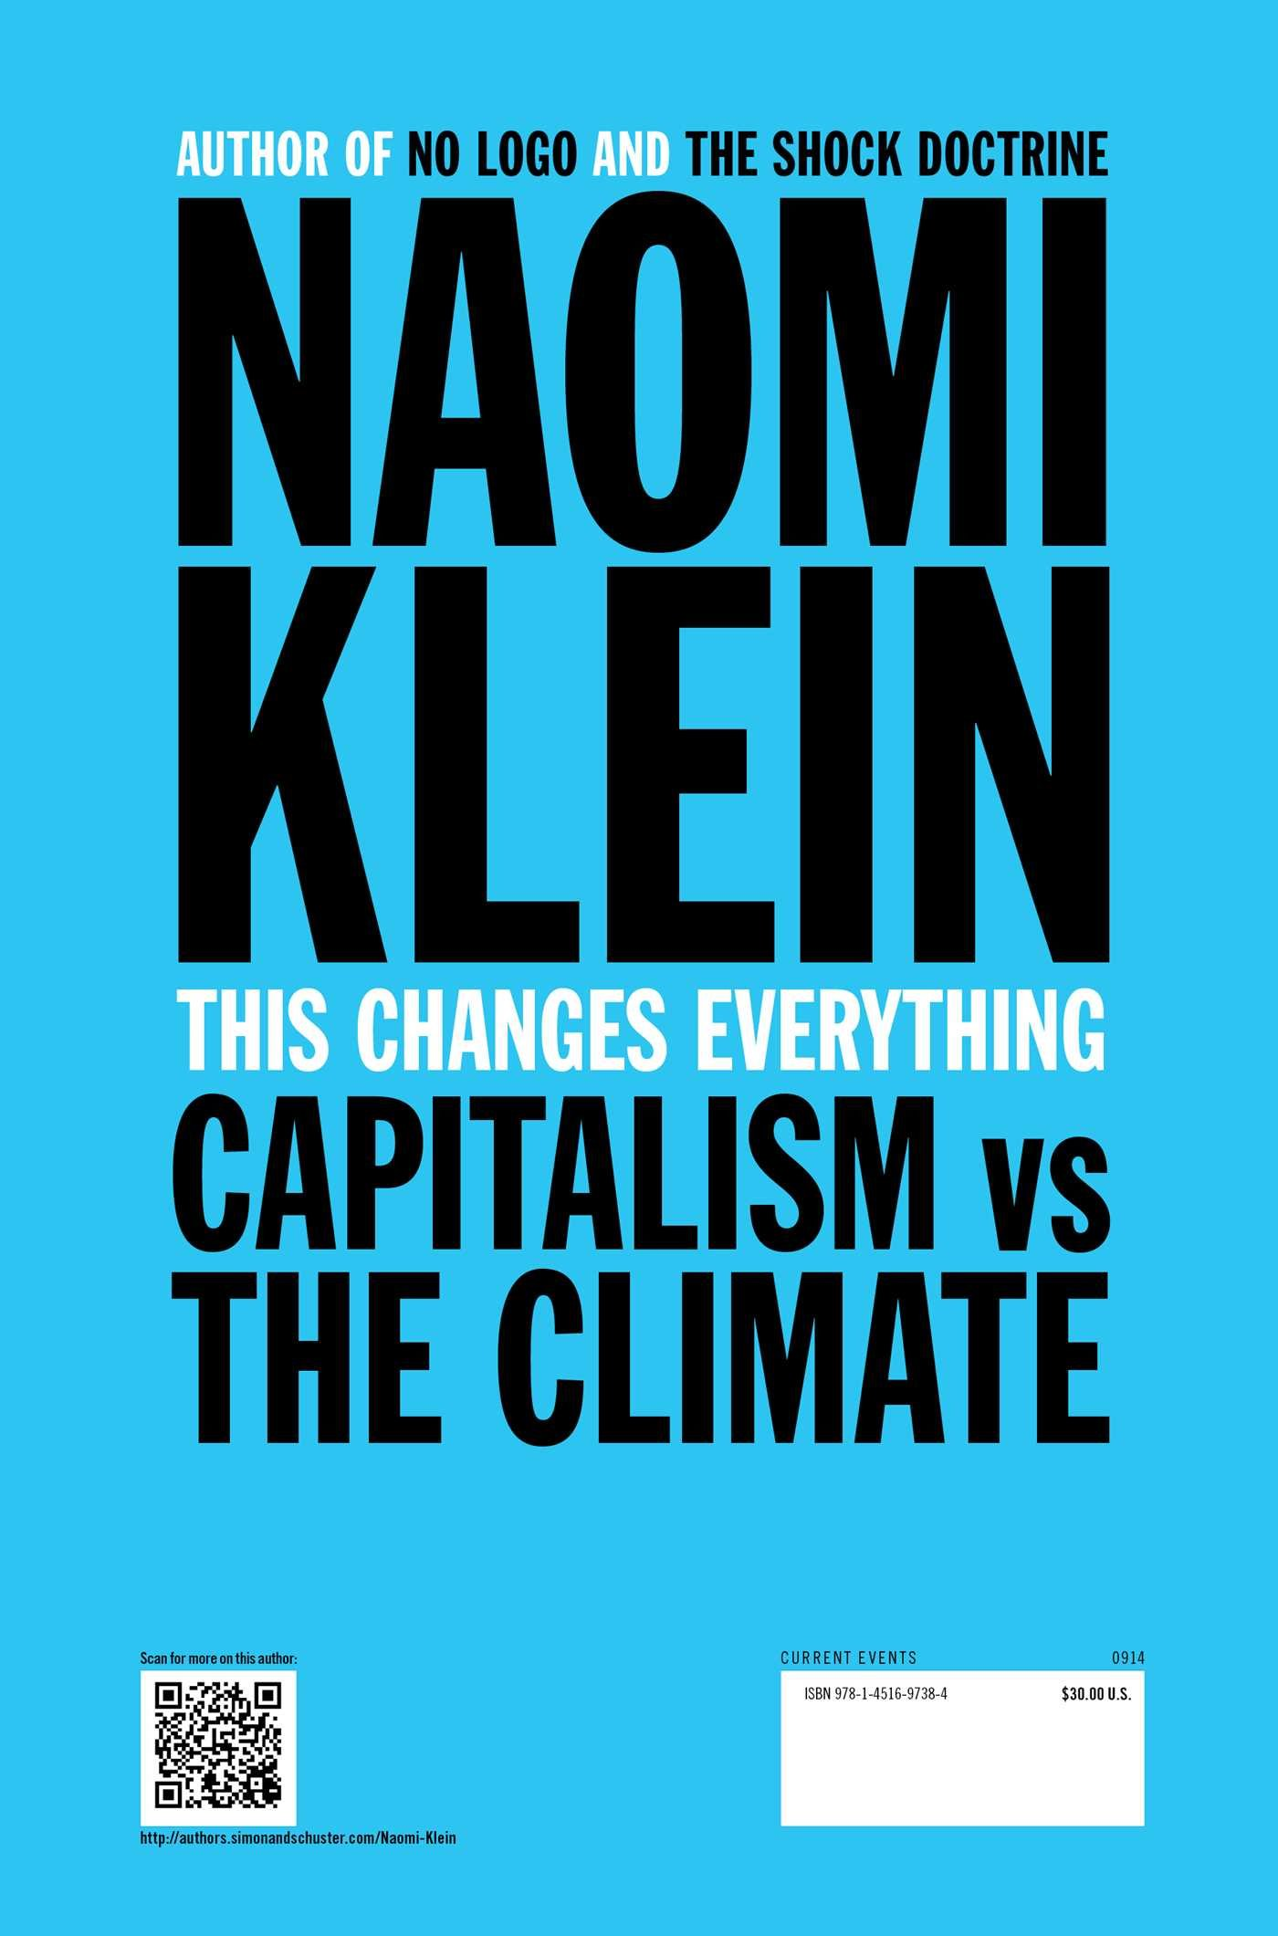
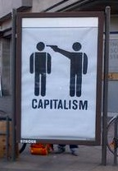
“We are remaking the world economy” – Christiane Figueres
“Climate policy is redistributing the world’s wealth” – Ottmar Edenhofer
“fundamental reorientation and restructuring of national and international institutions” – Frank Biermann

Slide 36
Players and incentives
Climate policy is often phrased as a scientific imperative
This is a categorical error, scientism
You can’t explain that in a tweet or soundbite
You can claim that climate science is uncertain, unsettled, or a hoax
If you do not like taxes, or feminists, or development aid, or transfers of sovereignty, or trade barriers, or government regulation -- your best bet is to attack climate science
Climate science is far from perfect

Slide 37
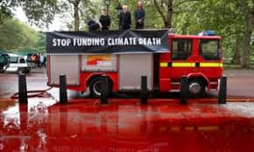
Conclusion
Climate change is a simple problem with a simple solution
Climate policy is stuck in exaggeration, polarisation, false promises

Slide 38
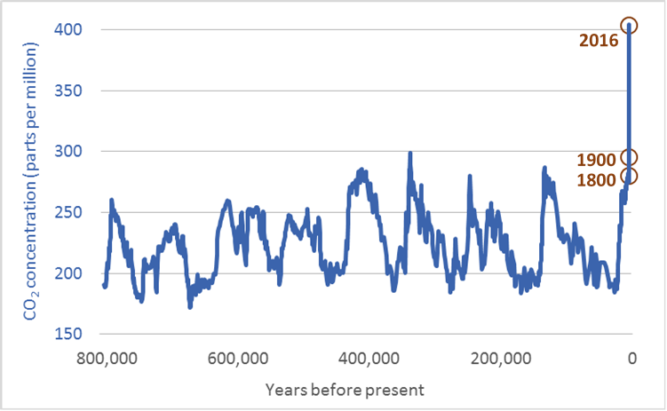
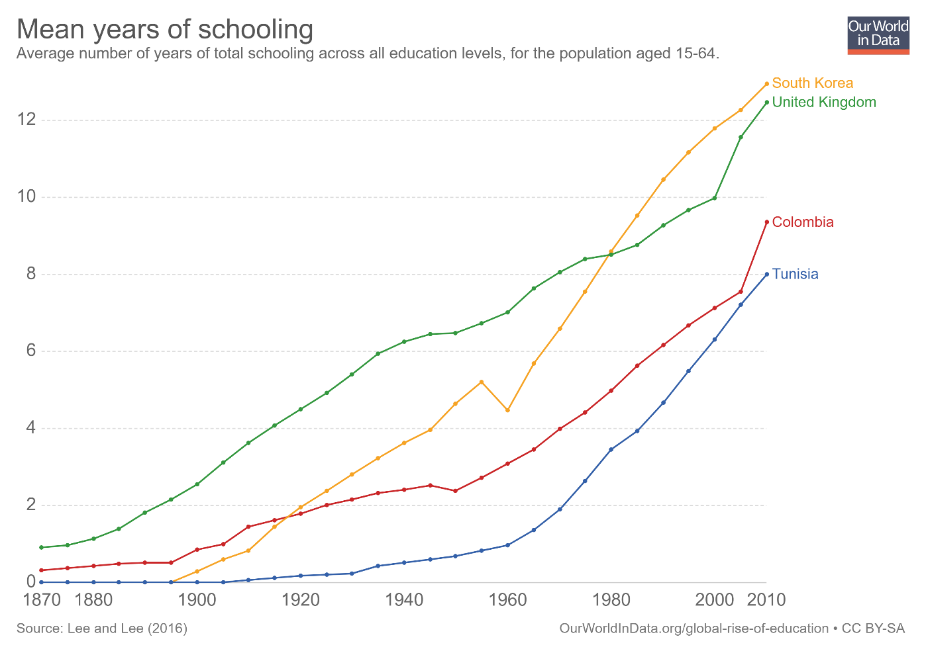
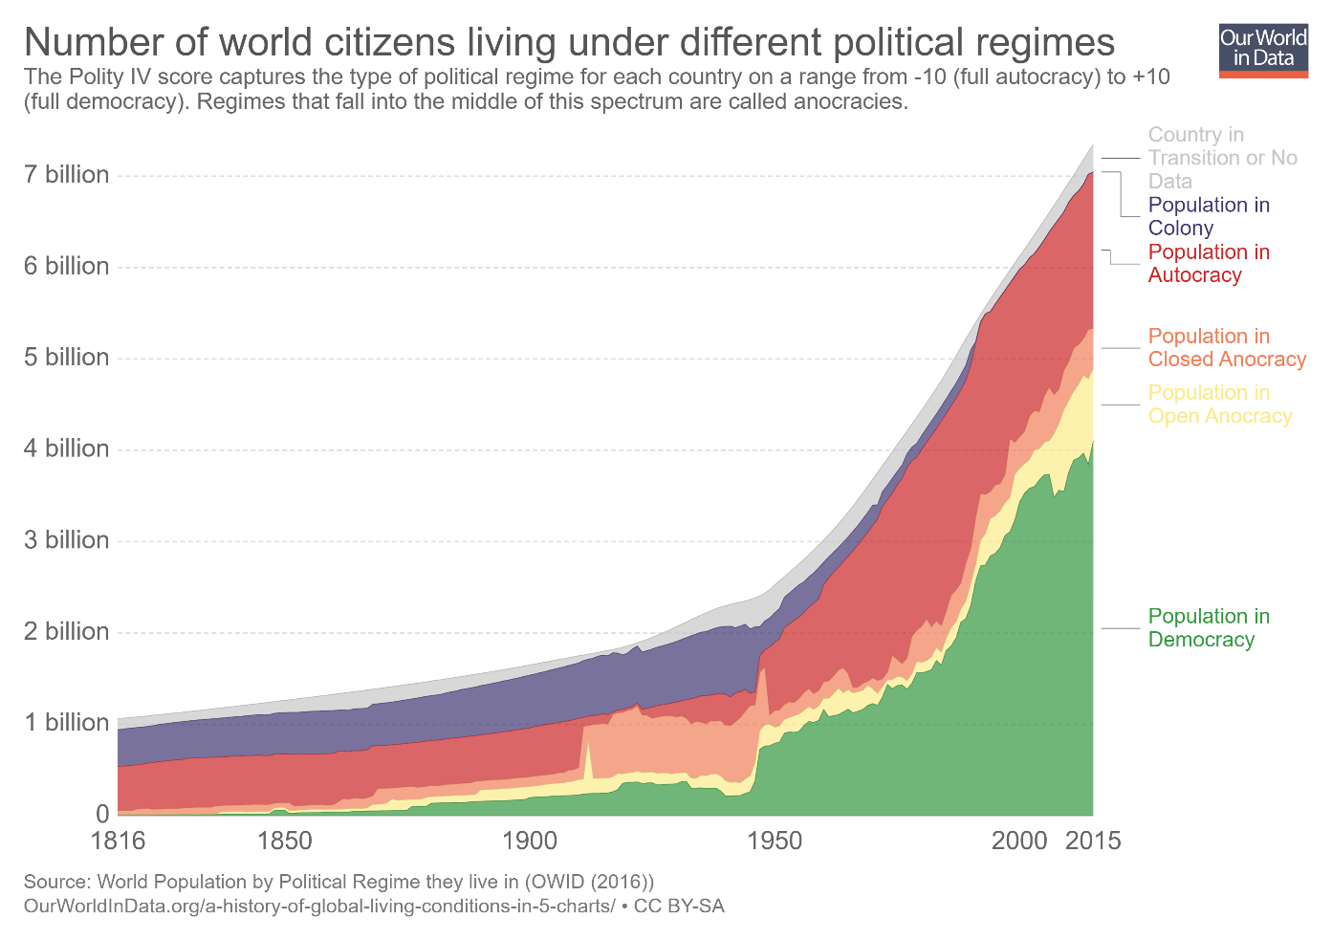
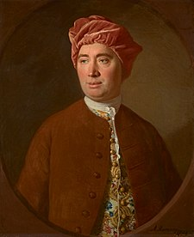
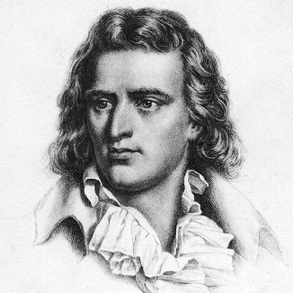
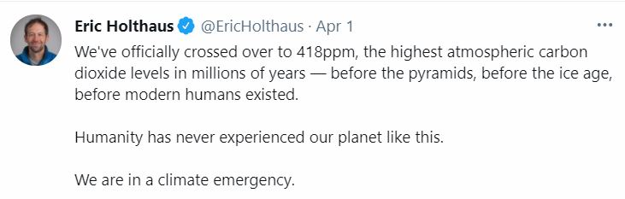
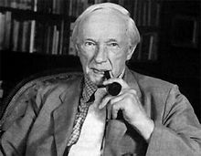
Fallacies
Climate change is often called unprecedented in a call for action
Is-ought, naturalistic fallacy

Slide 39
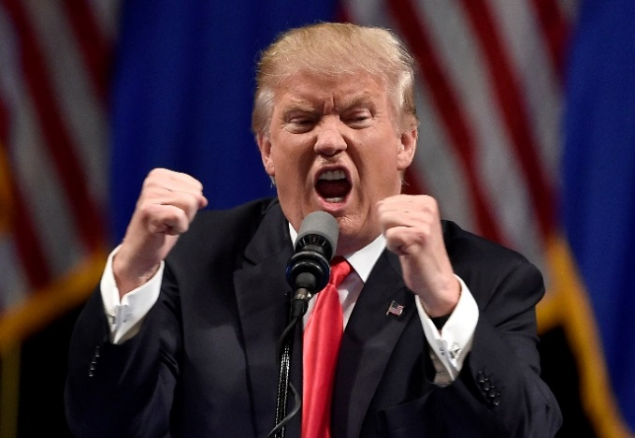
Paris Agreement
14.3 The outcome of the global stocktake shall inform Parties in updating and enhancing, in a national determined manner, their actions […].
15.1/2 […] compliance […] in a manner that is transparent, non-adversarial and non-punitive […]
28.1 […] Party may withdraw from this agreement

Slide 40
Paris Agreement
2a [h]old[…] the increase in the global average temperature to well below 2°C above pre-industrial levels and pursu[e] efforts to limit the temperature increase to 1.5°C above pre-industrial levels, recognizing that this would significantly reduce the risks and impacts of climate change

Slide 41
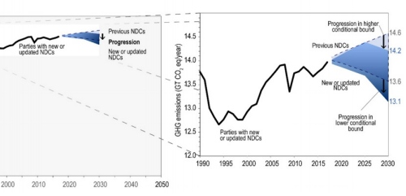

Slide 42
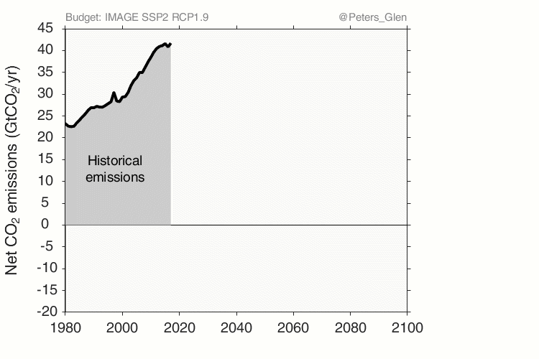

Slide 43


Slide 44
Committed emissions from existing and proposed energy infrastructure
(about 846 gigatonnes CO₂) thus represent more than the entire carbon
budget that remains if mean warming is to be limited to 1.5°C
with a probability of 66 to 50 per cent (420–580 gigatonnes CO₂),
and perhaps two-thirds of the remaining carbon budget if mean
warming is to be limited to less than 2 °C (1,170–1,500 gigatonnes CO₂).

Slide 45
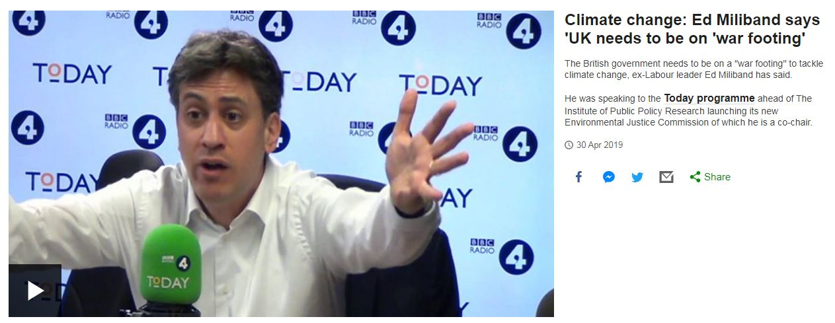

Slide 46
War as an analogy
Mobilisation is useful for a short-term effort against an external enemy
You should only declare a war if there is someone to sign a peace treaty with

Slide 47
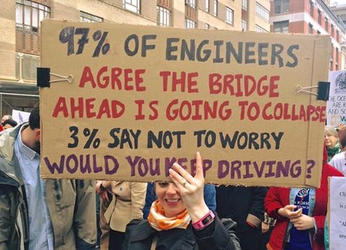
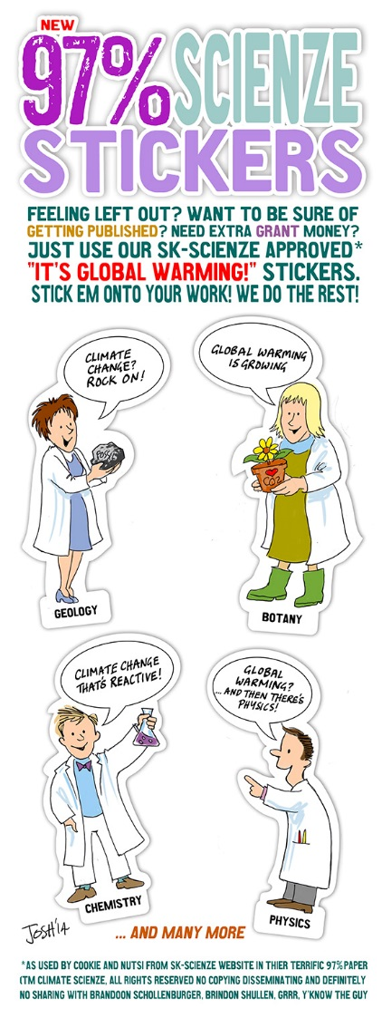
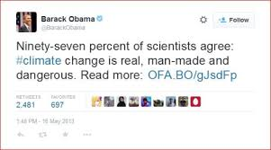
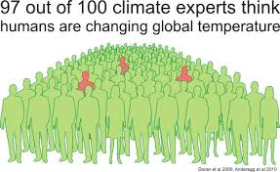
Fallacies
Climate change is often presented as a consensus

